Slide 1

Storm Weather Data
Group 1: Arne Muller, Erik Pacheco, Michael Do, Shadman Sayef, & Steven Vi

Slide 2

Data Source
We used information from National Centers for Environmental Information (NOAA)
This is where we get our csv files from:
https://www.ncei.noaa.gov/pub/data/swdi/stormevents/csvfiles/

Slide 3
Why this Data?
We want to analyze storm events and their details to predict when and where storms are coming.
We also want to gain insight of the damage storms can cause as well.

Slide 4
Data Size and Information
We used several data for this presentation. We used storm events from 2010 and 2011.
StormEvents_details-ftp_v1.0_d2010_c20220425.csv.gz
StormEvents_details-ftp_v1.0_d2011_c20230417.csv.gz
StormEvents_fatalities-ftp_v1.0_d2010_c20220425.csv.gz
StormEvents_fatalities-ftp_v1.0_d2011_c20230417.csv.gz
StormEvents_locations-ftp_v1.0_d2010_c20220425.csv.gz
StormEvents_locations-ftp_v1.0_d2011_c20230417.csv.gz
Data size is more than 100 mb combined.
GitHub Link-https://github.com/MichaelCIS/3200_Stormevent.git

Slide 5
Time & Geo Location/Map of 2010 & 2011 Storm Events

Slide 6
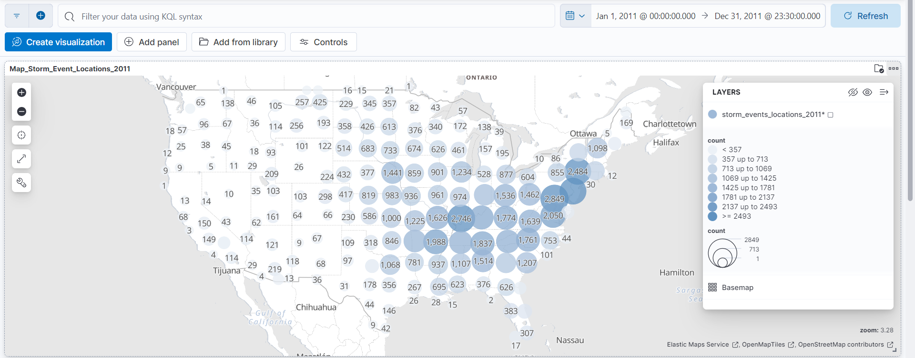
Storm Locations 2011
Most storm events in lower middle east and upper east coast states

Slide 7
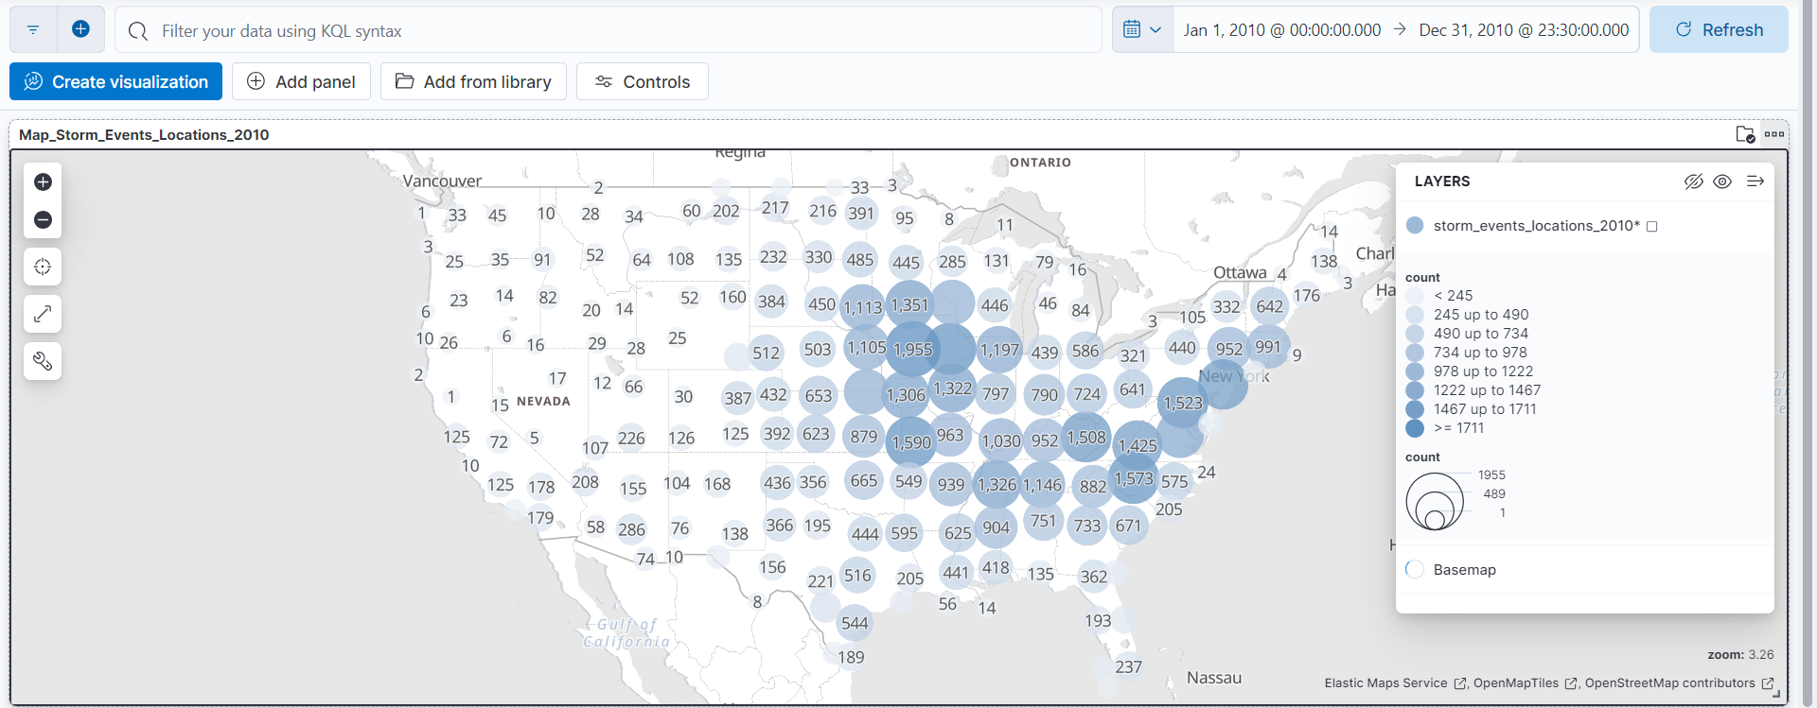
Storm Locations 2010
Most storm events in middle east and east coast states

Slide 8
Fatalities Visual Chart from 2010 & 2011 Storm Events

Slide 9
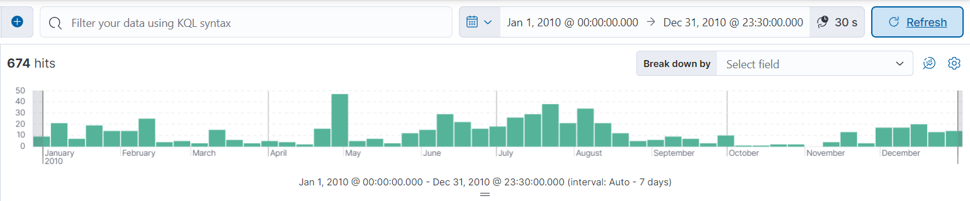
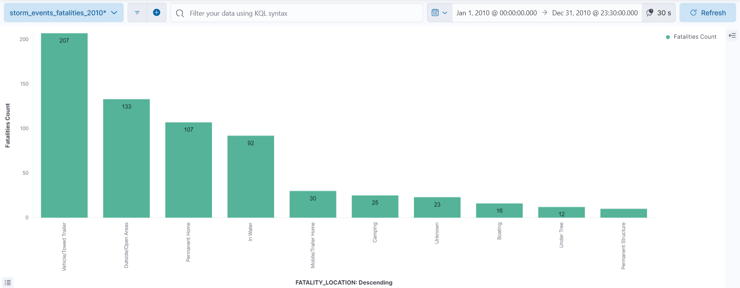
Storm Events Fatalities 2010
Time Period: Most deaths occurred around summertime
Locations: Most deaths occurred in vehicles and towed trailers

Slide 10
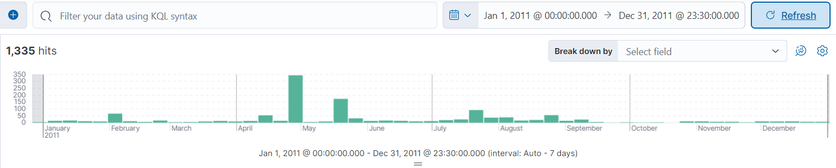
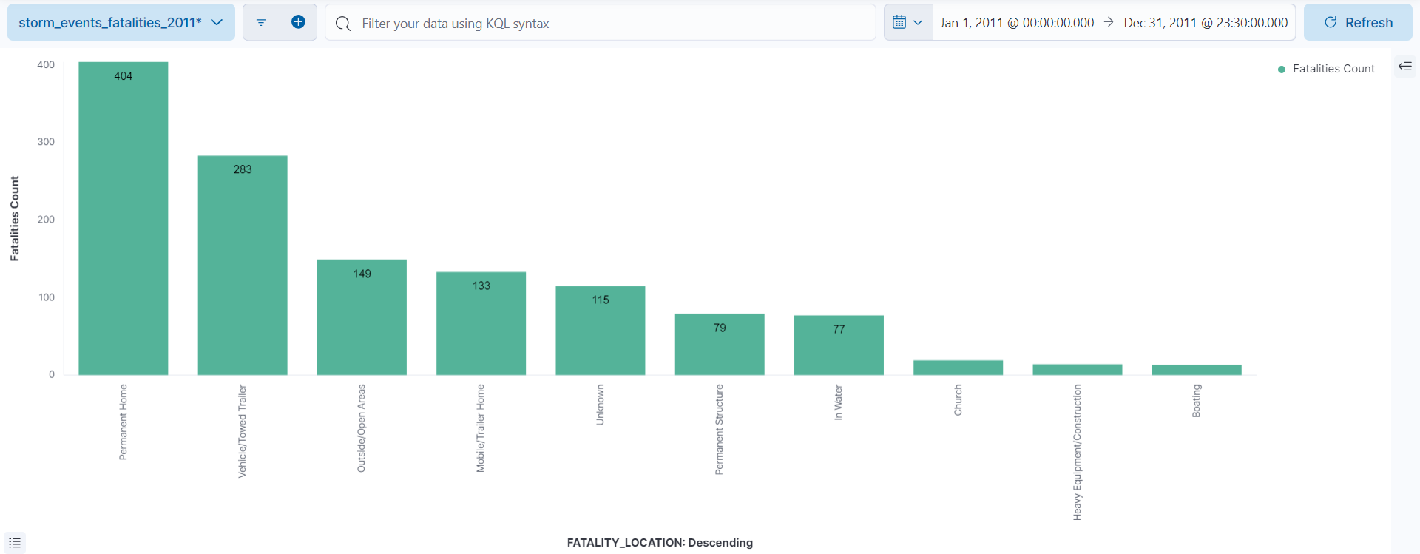
Storm Events Fatalities 2011
Time Period: Most deaths occurred around late spring / early summer
Locations: Most deaths occurred in permanent homes

Slide 11
Visual Chart of 2010 Storm Events

Slide 12
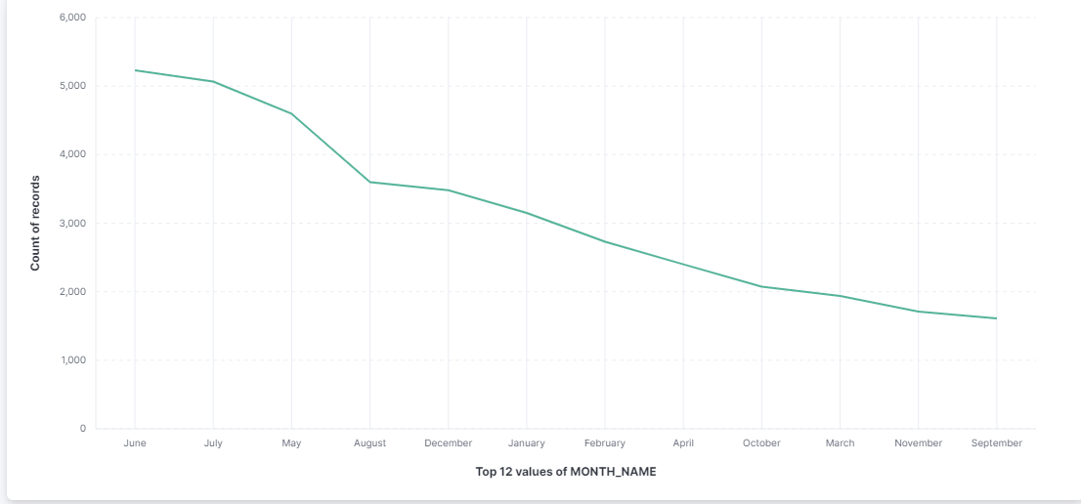
Months of the Year w/ Most Weather Events
This visualization shows the amount of storm events throughout the year.
This shows that June is the month with the most storm events overall.

Slide 13
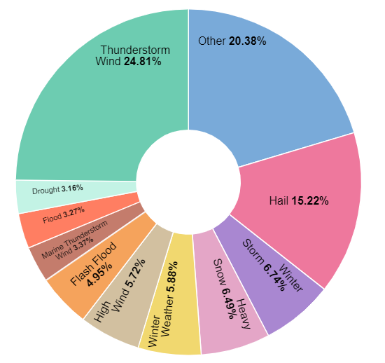
Types of Weather Events
This visualization describes top 10 causes/types of natural storm events.
As we can see, most storm events as part of the dataset are thunderstorm wind events.

Slide 14
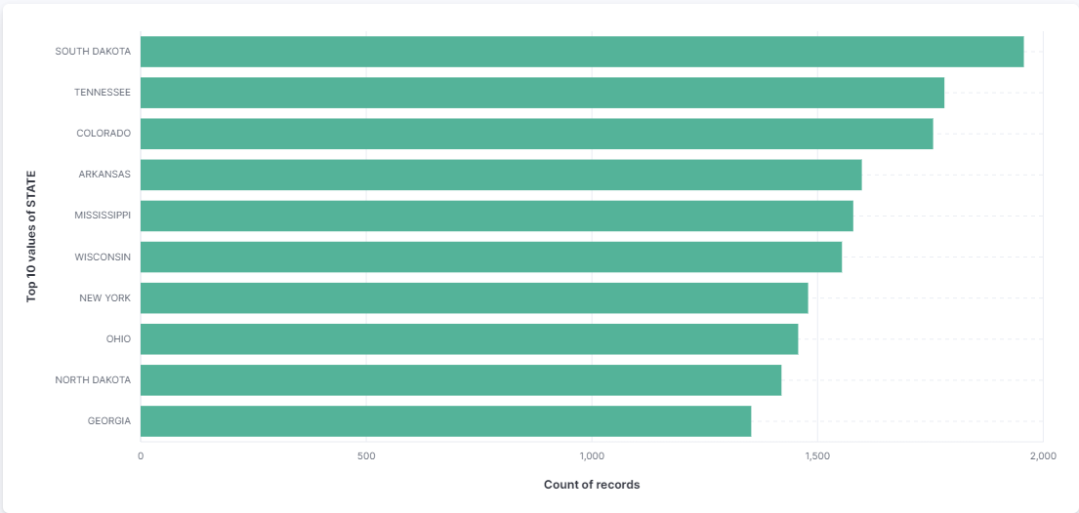
Top 10 States with Weather Events
This visualization describes the top 10 states that experience weather or storm events.
South Dakota has the most.

Slide 15
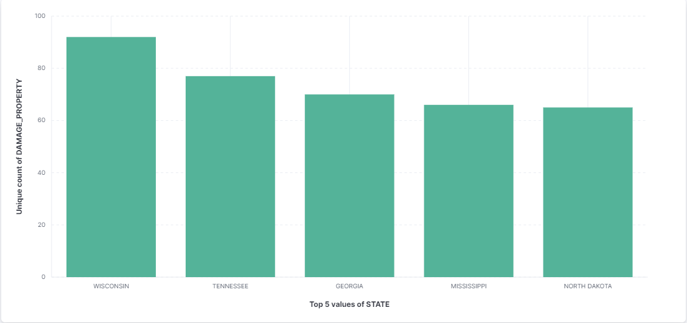
Top 5 States with Property Damage
This visualization describes the top 5 states that experience the most property damage.
Wisconsin experienced the most property damage due to storm events.

Slide 16
Visual Chart of 2011 Storm Events

Slide 17

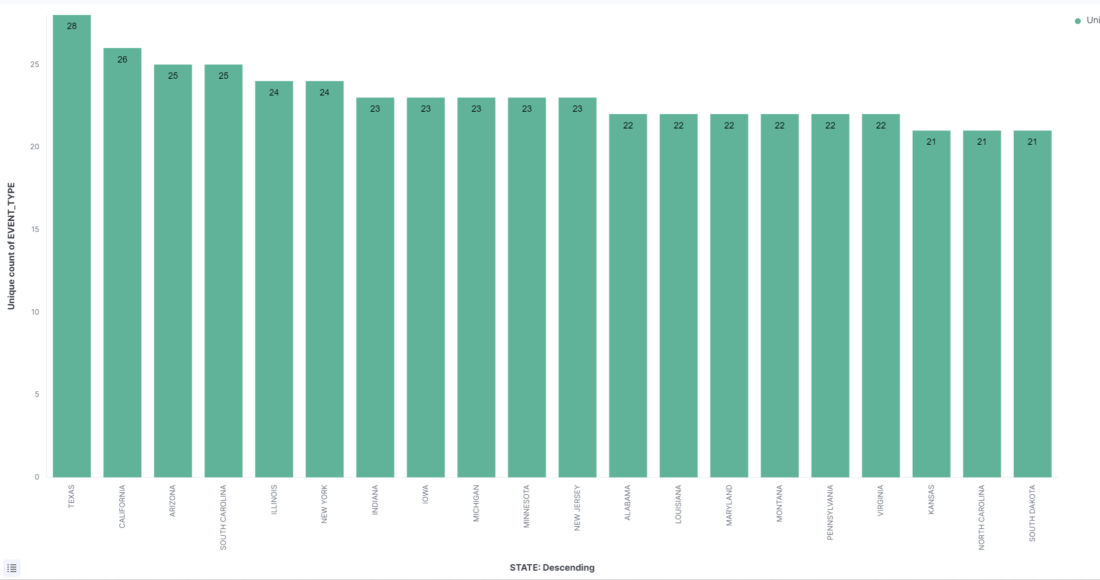
Number of Storm Events in 20 States
Texas the most storm event to occur within their state
28 storm events has taken place within the state of Texas
Second state with the most storm event to happen is in the state of California
26 Storm event

Slide 18

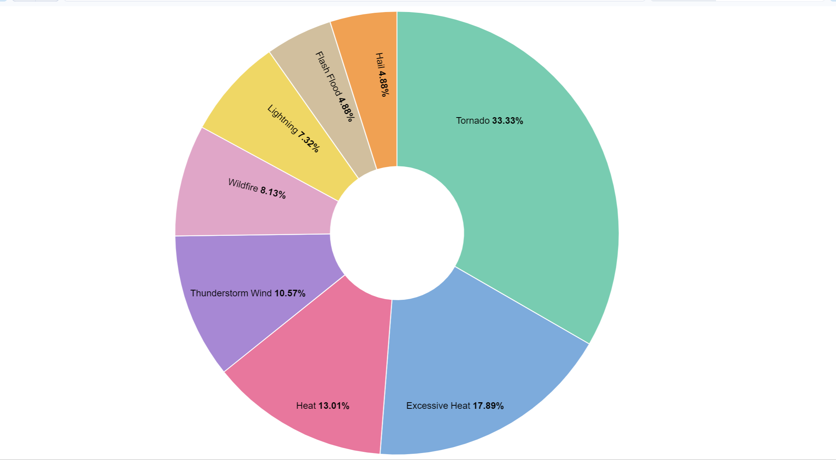



Percentage of Direct Injury from Different Types of Storm
Top 8 Storm event to cause direct injury
Tornado is one of the storm event to have a large percentage in direct injury
33.33% of direct injury
Second being excessive heat at 17.89%

Slide 19
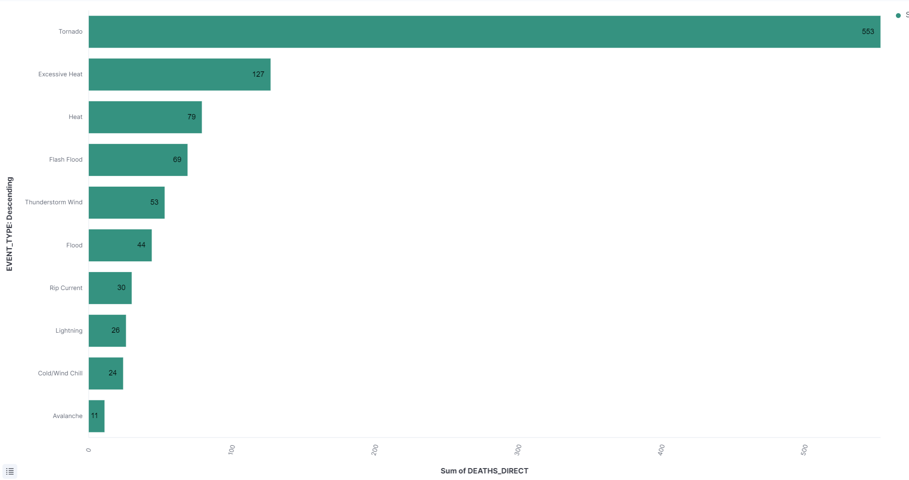
Ten Storm Events in Direct Death
When it comes to direct death it was founded that tornado were more involved in causing direct death
With the sum of 553 direct death
Looking into the second storm event to cause the most direct death is Excessive Heat
With the sum of 127 direct death

Slide 20
Predictive Analysis

Slide 21

Influencers - 2010
From here, it gives us the idea of how significant each feature is.
Highest one is EVENT_TYPE: 9.95

Slide 22
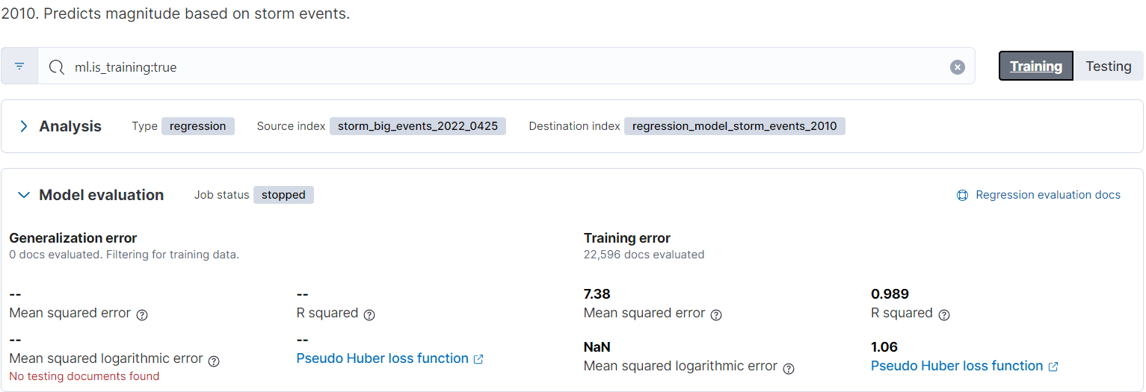
Training Data - 2010
MSE is 7.38
R-squared is 0.989
This means that this data has good accuracy as to predicting future storm events based on the magnitude of the type of event.

Slide 23
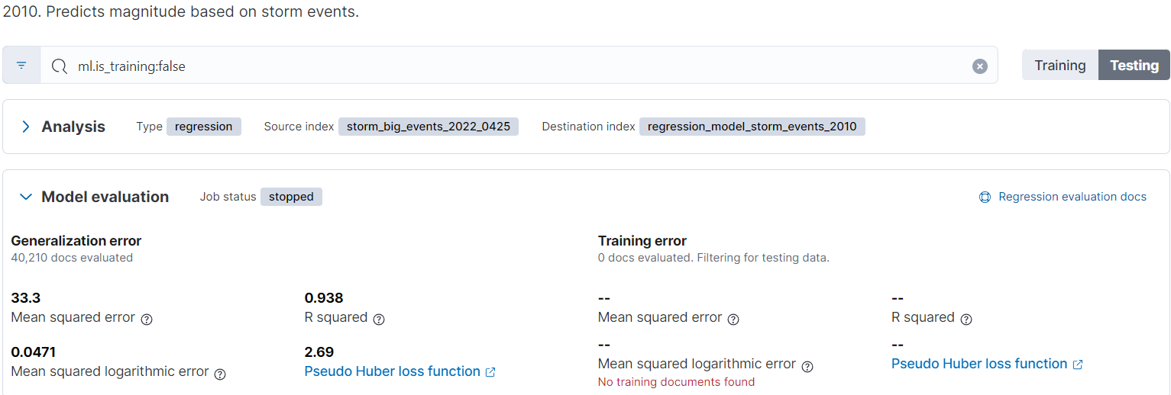
Testing Data - 2010
MSE is 33.3
R-squared is 0.938

Slide 24
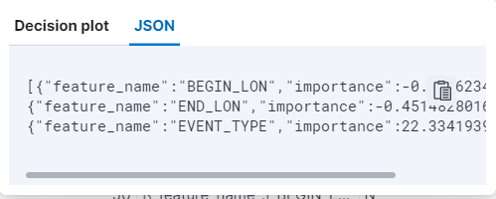
Influencers - 2011
The highest one being EVENT_TYPE with 22.334193

Slide 25
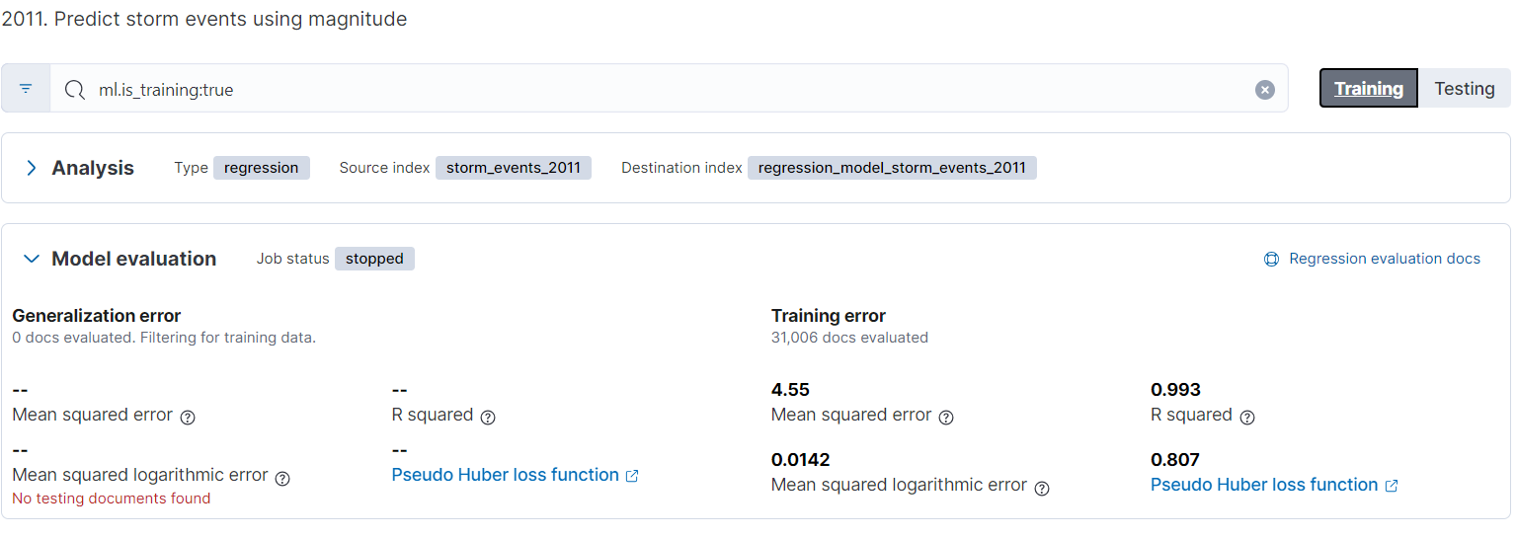
Training Data - 2011
MSE is 4.55
R-squared is 0.993

Slide 26
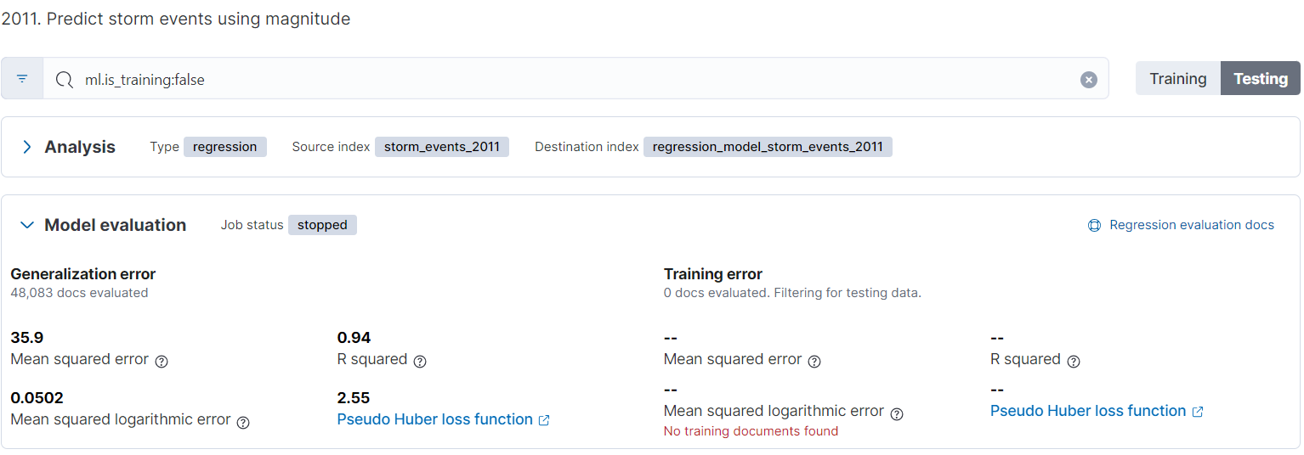
Testing Data - 2011
MSE is 35.9
R-squared is 0.94

Slide 27
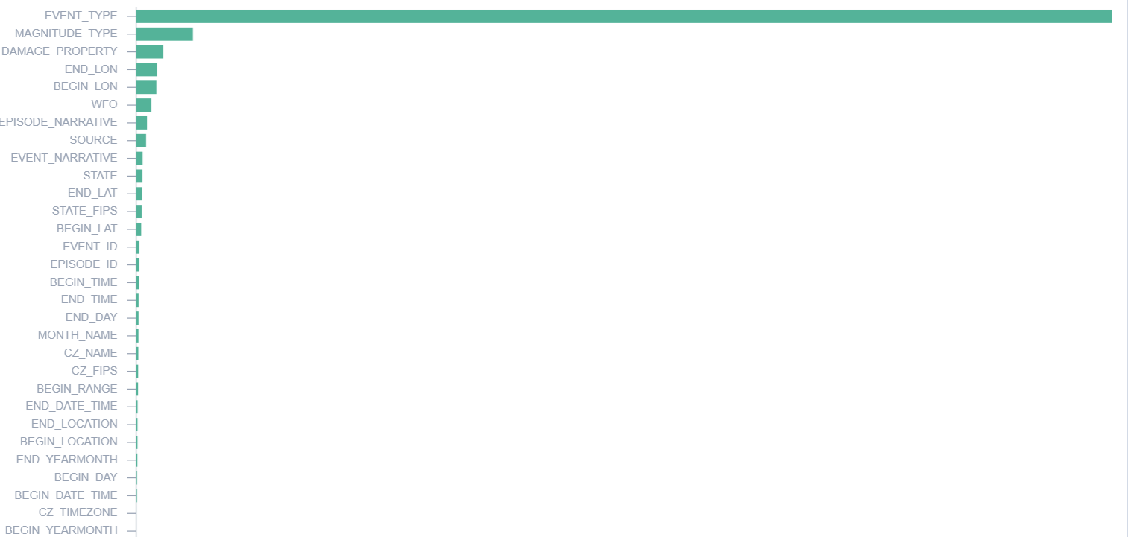
Regression Data with Feature Importance
This is Storm Events data from 2011.
EVENT_TYPE has massive weight as to predicting storm events
Using magnitude as our dependent variable, we use it predict future storm events

Slide 28
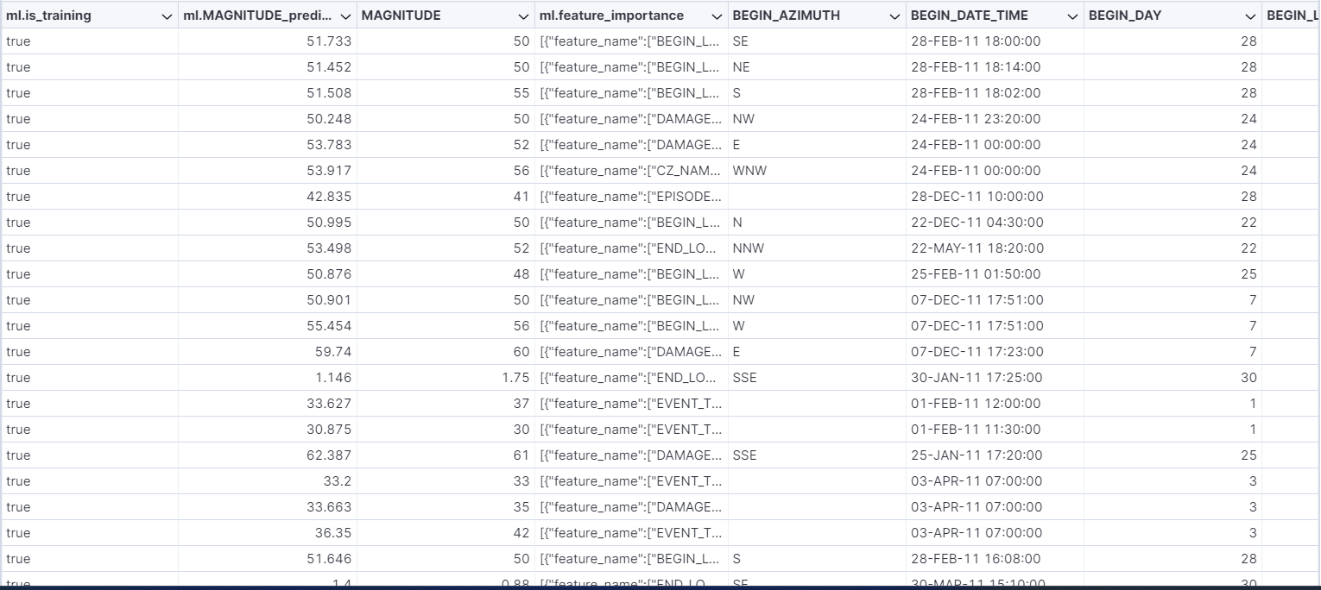
Machine Learning Feature Importance
From this, we can see the labels from this dataset
We can also see machine learning feature importance as well.

Slide 29
Insights
Majority of the storm events happen around mid-East and eastern States of the U.S. for both 2010 and 2011
Most deaths occur in vehicles and towed trailers
Majority of the storm events happen around late spring to summer
Most storm events happen to be thunderstorms for 2010.
South Dakota and Tennessee had the most storm events in 2010
Texas has the most storm events in 2011
Most storm injuries were tornadoes in 2011
For machine learning, we learned that magnitude of the storms depend on the event types, which makes sense. Depending on the event type of the storm, the higher or lower of the magnitude of the storm.

Slide 30

The End

